Slide 1


Slide 2
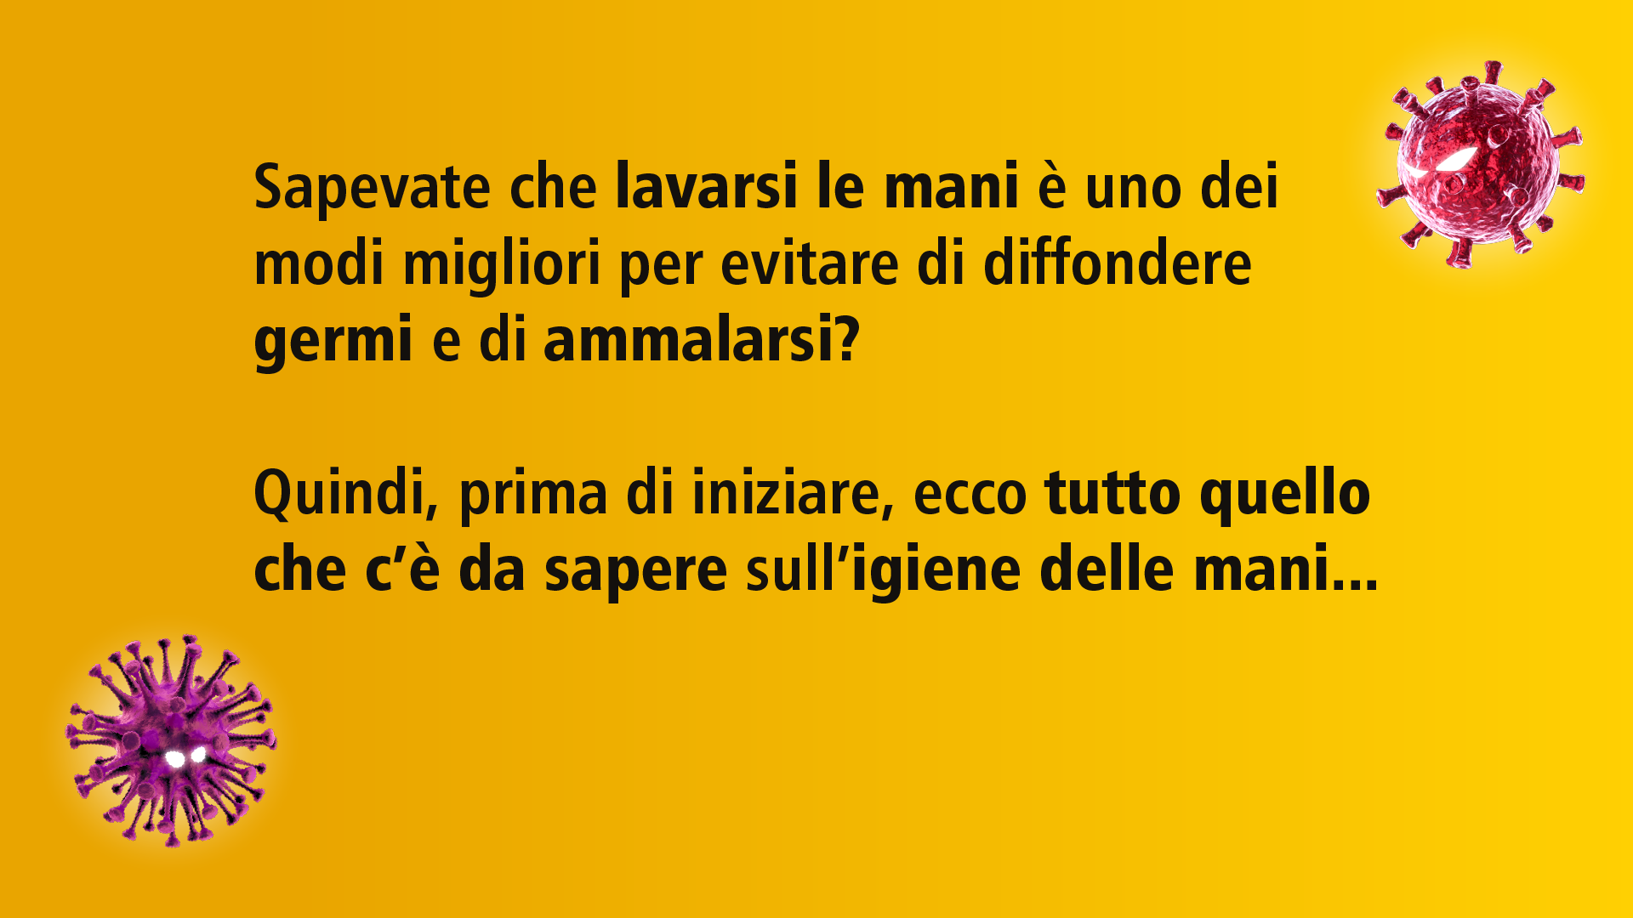
Source: https://www.who.int/gpsc/5may/Hand_Hygiene_Why_How_and_When_Brochure.pdf

Slide 3
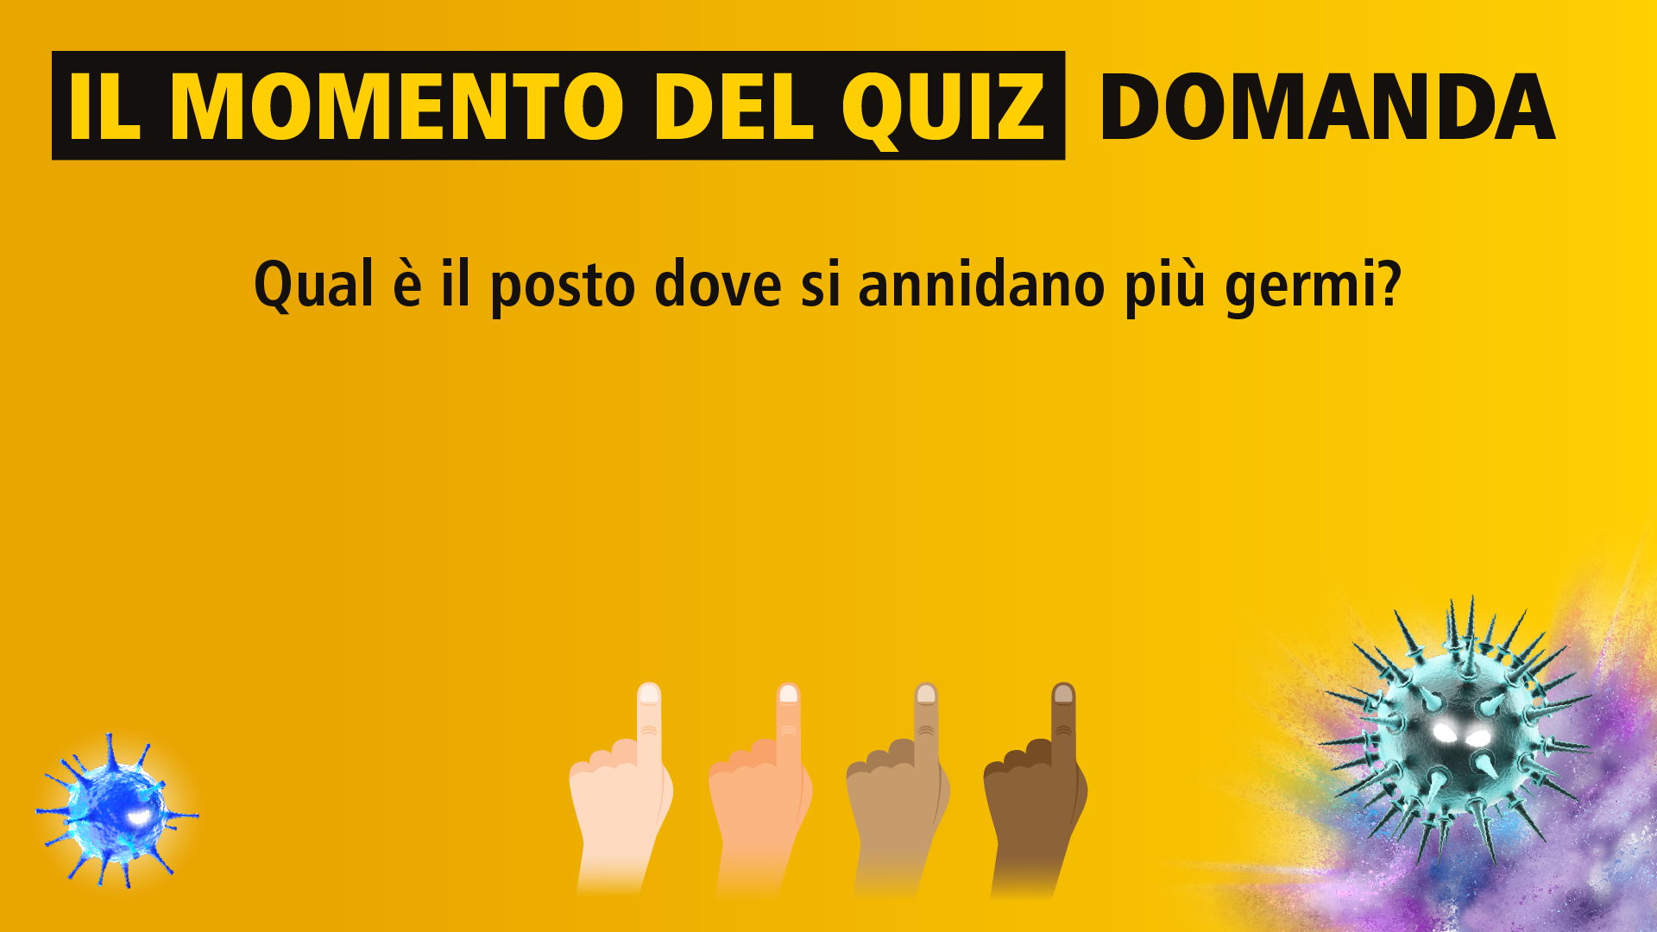

Slide 4
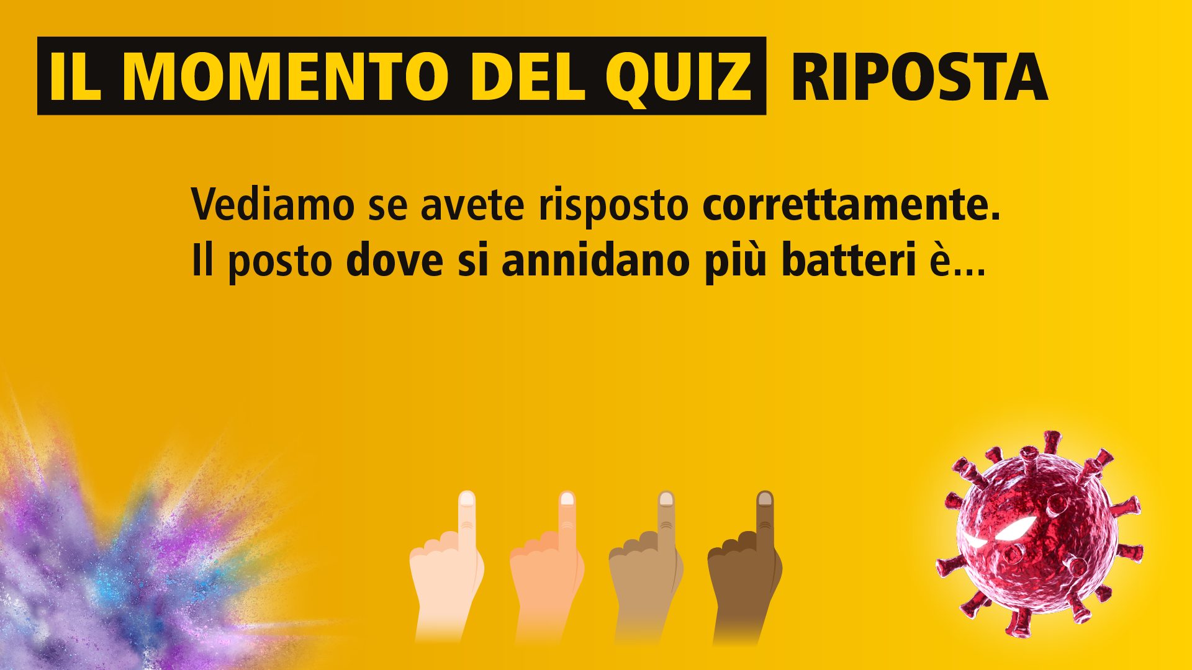

Source: https://www.which.co.uk/news/2013/09/how-clean-is-your-ipad-a-which-hygiene-investigation/

Slide 5
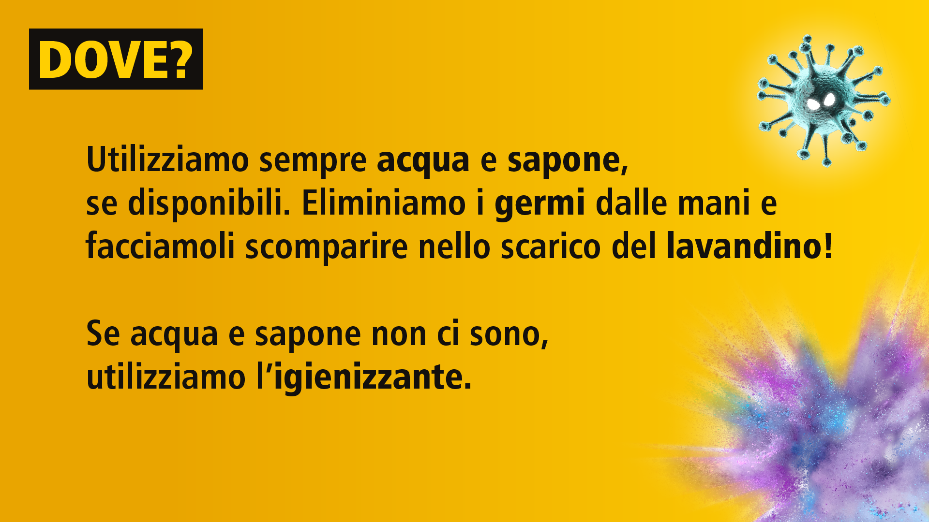

Slide 6
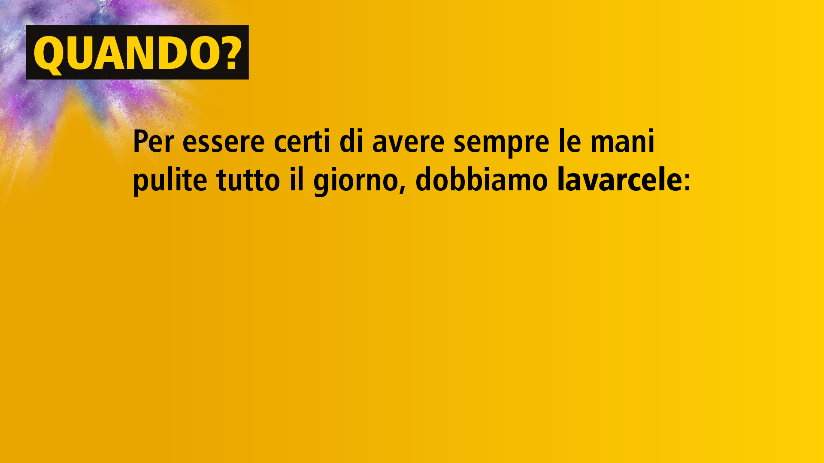



Slide 7
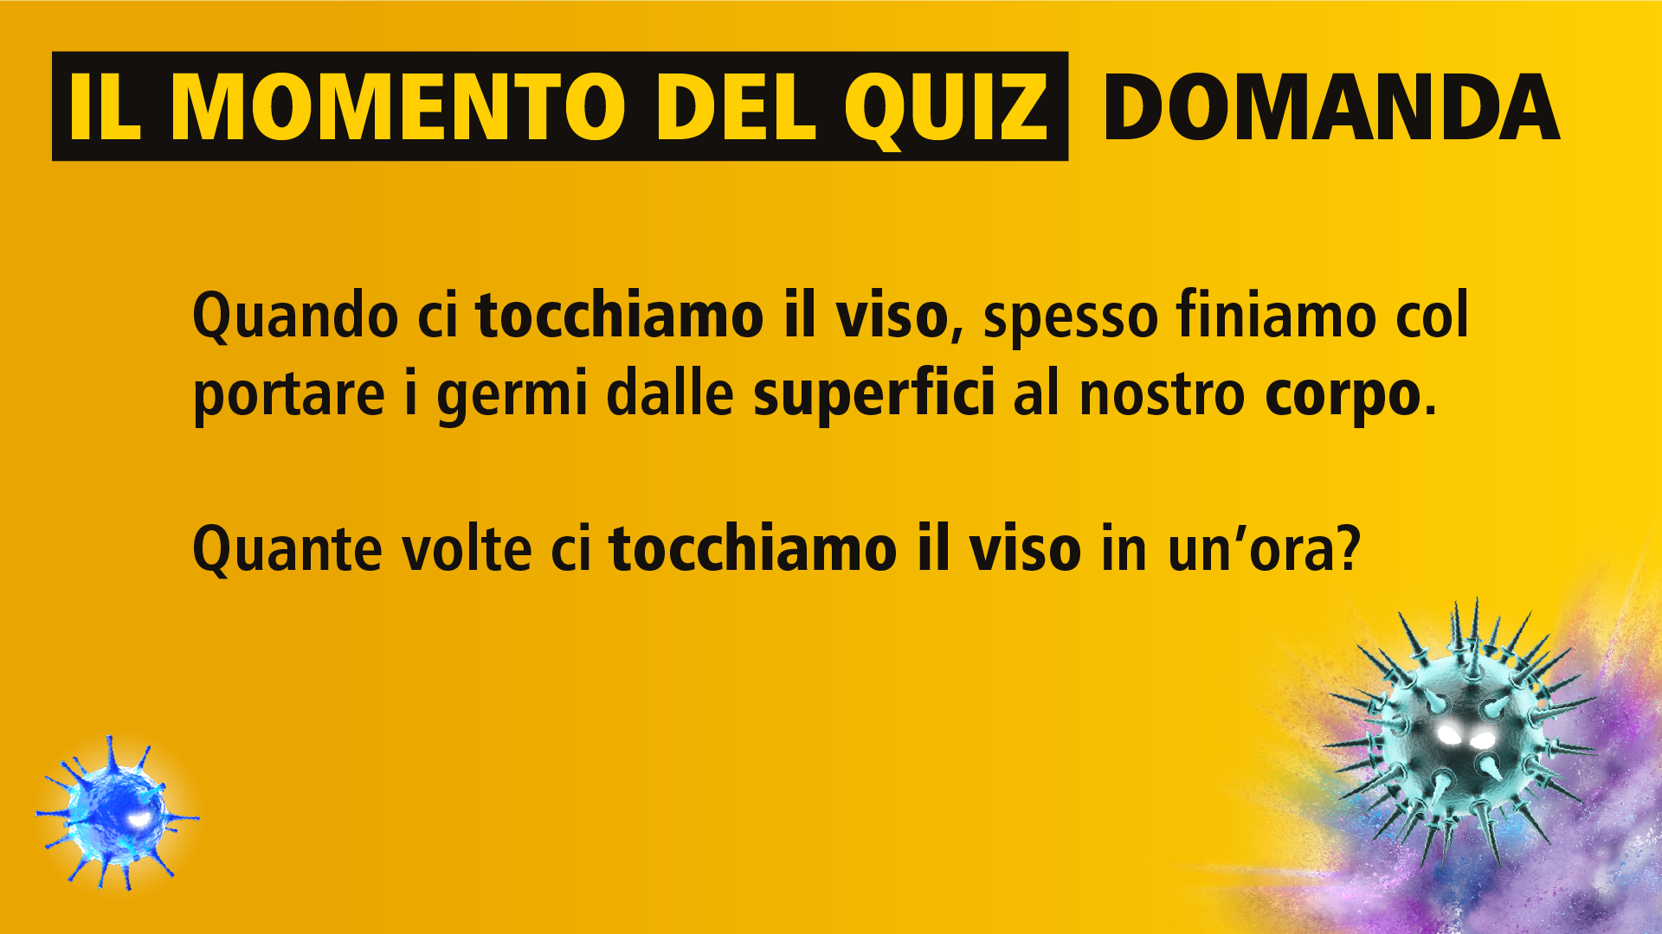

Slide 8
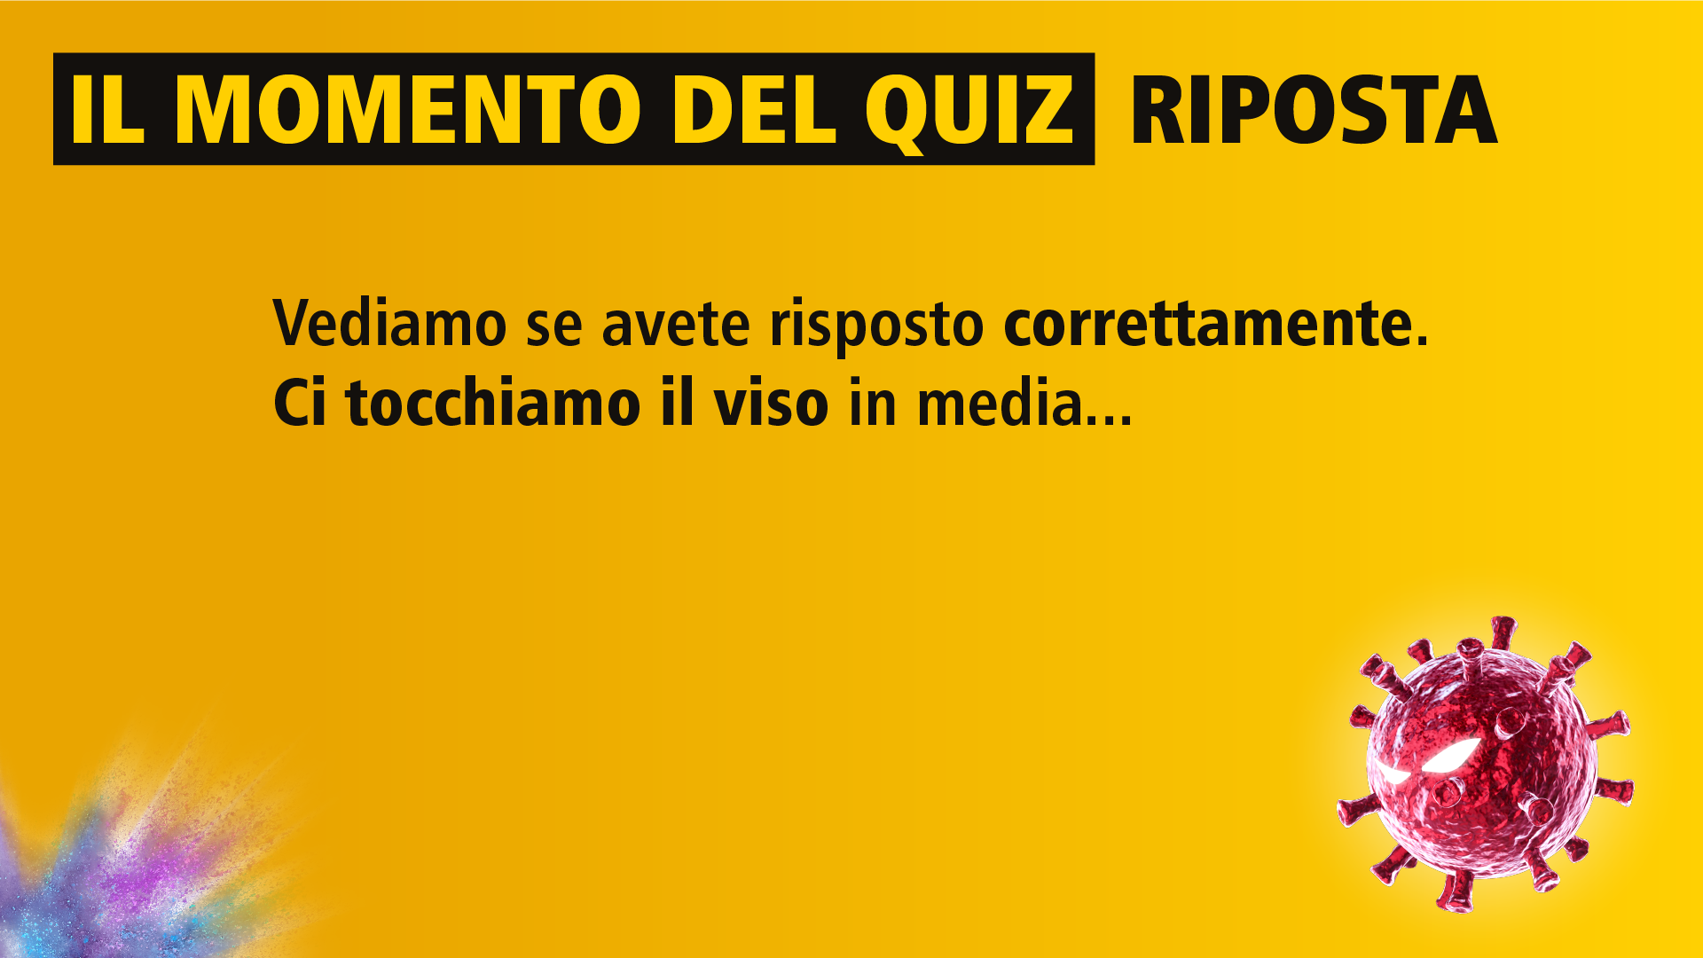


Source: https://www.forbes.com/sites/jvchamary/2020/07/30/coronavirus-face-touching/?sh=6b13d5b8375f

Slide 9
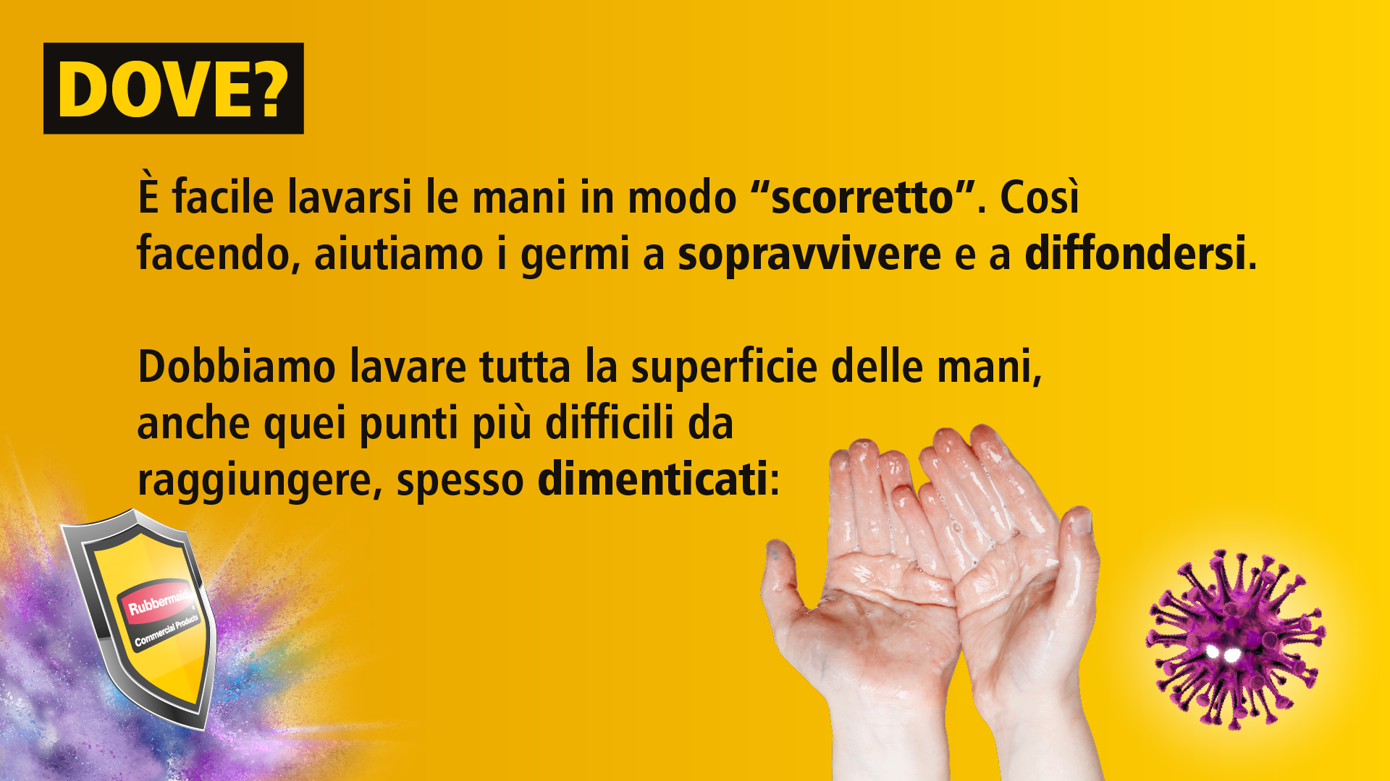






Slide 10



Slide 11
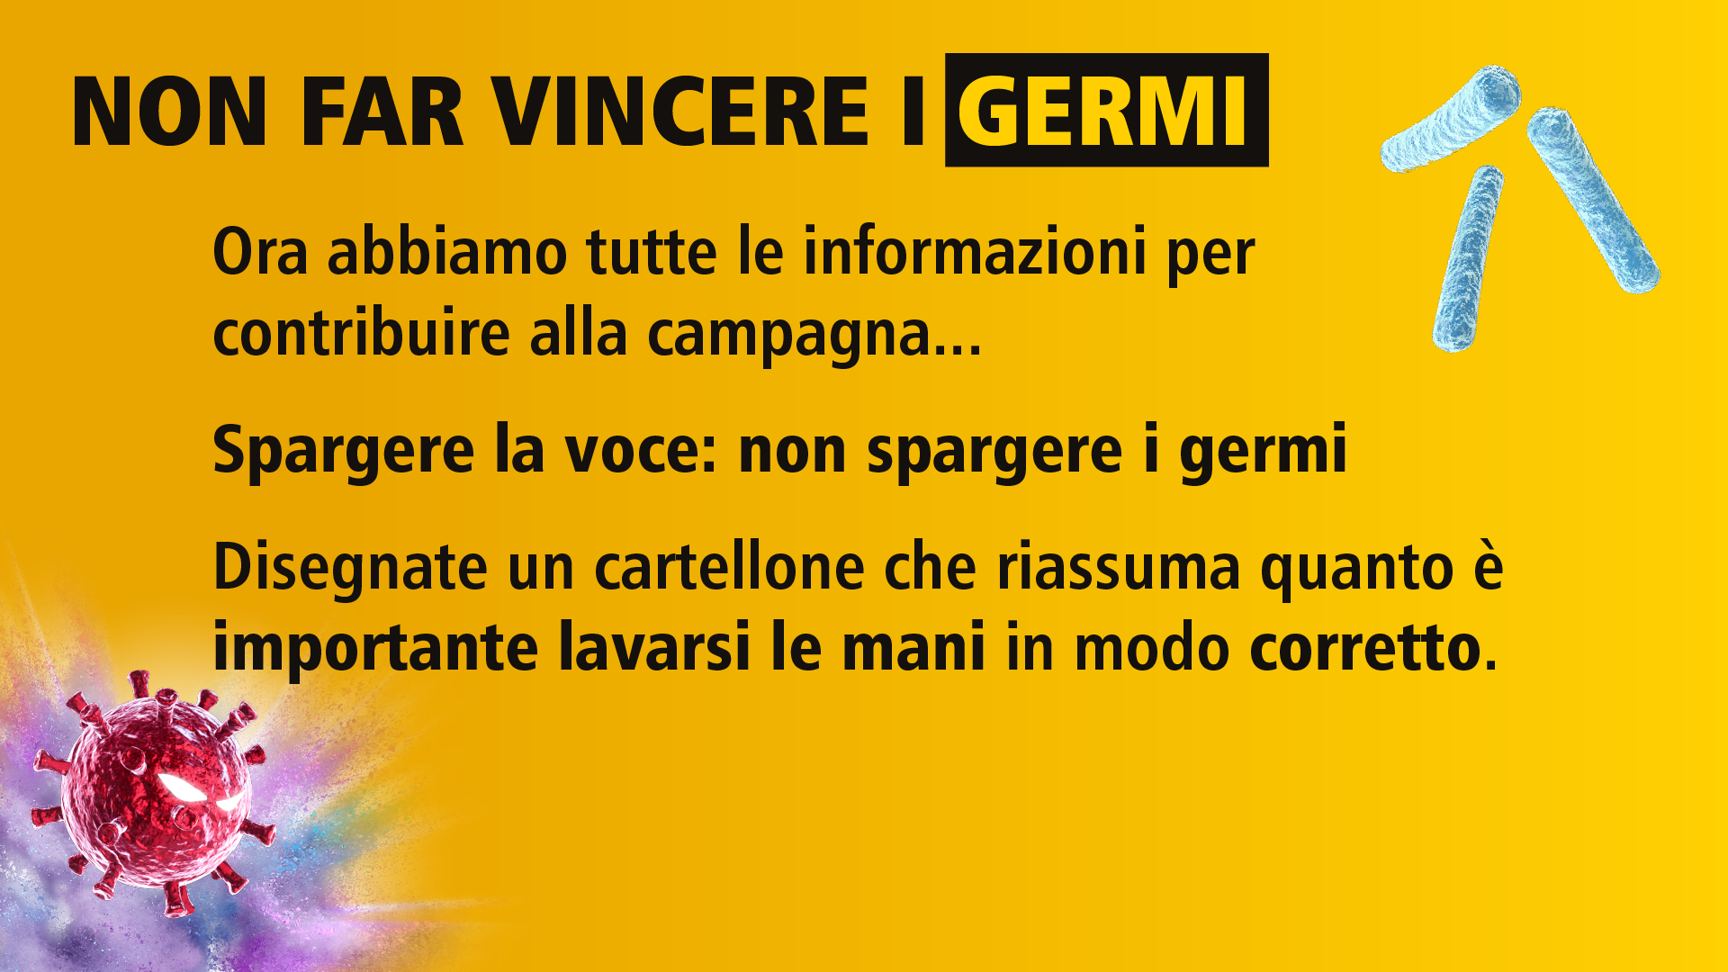

Slide 12


Slide 13

Gli insegnanti possono qui fornire ulteriori informazioni per aiutare gli alunni a compiere la loro missione!

