Slide 1


Slide 2
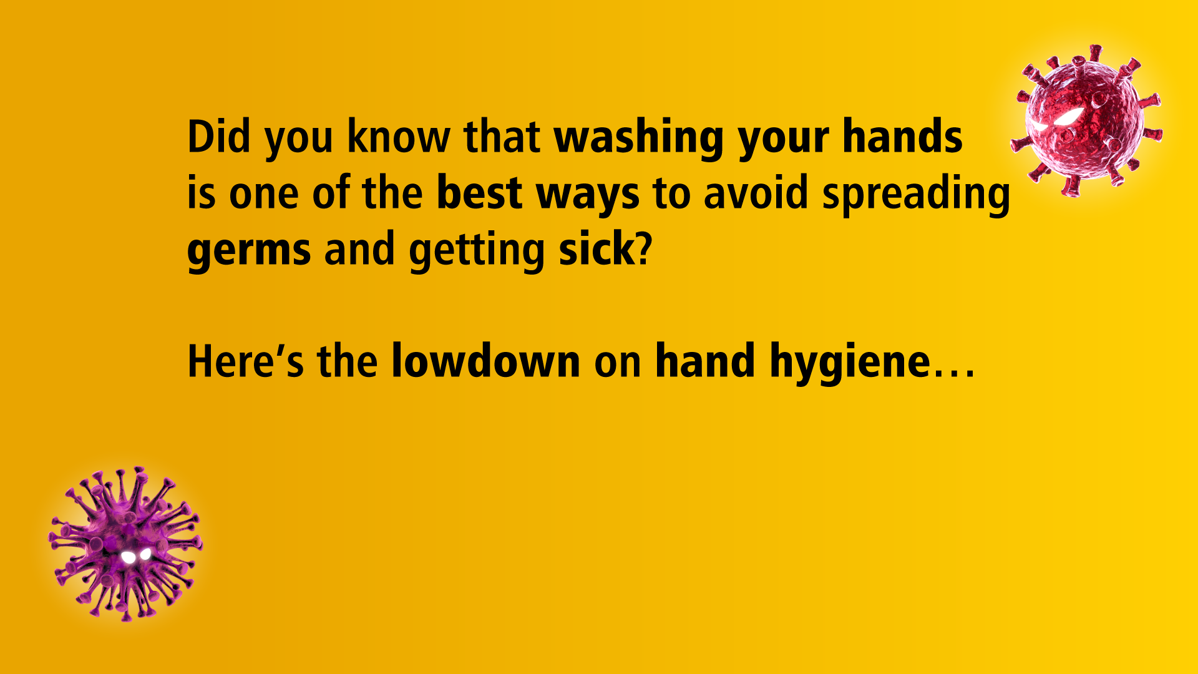
Source: https://www.who.int/gpsc/5may/Hand_Hygiene_Why_How_and_When_Brochure.pdf

Slide 3
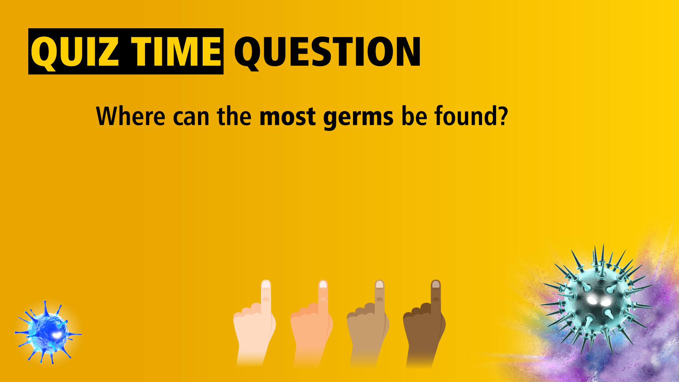




Slide 4
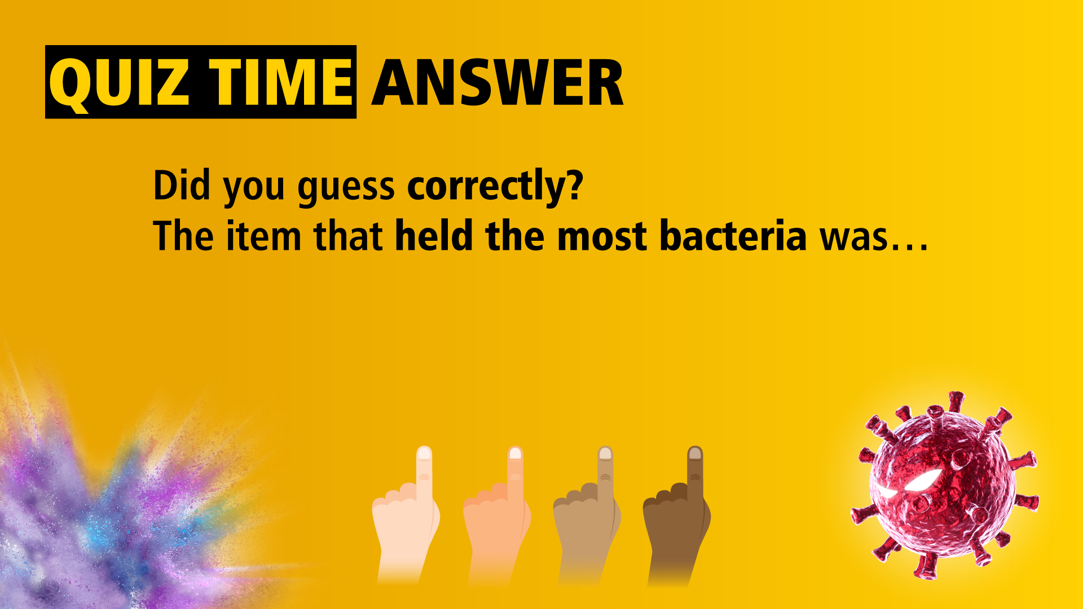

Source: https://www.which.co.uk/news/2013/09/how-clean-is-your-ipad-a-which-hygiene-investigation/

Slide 5
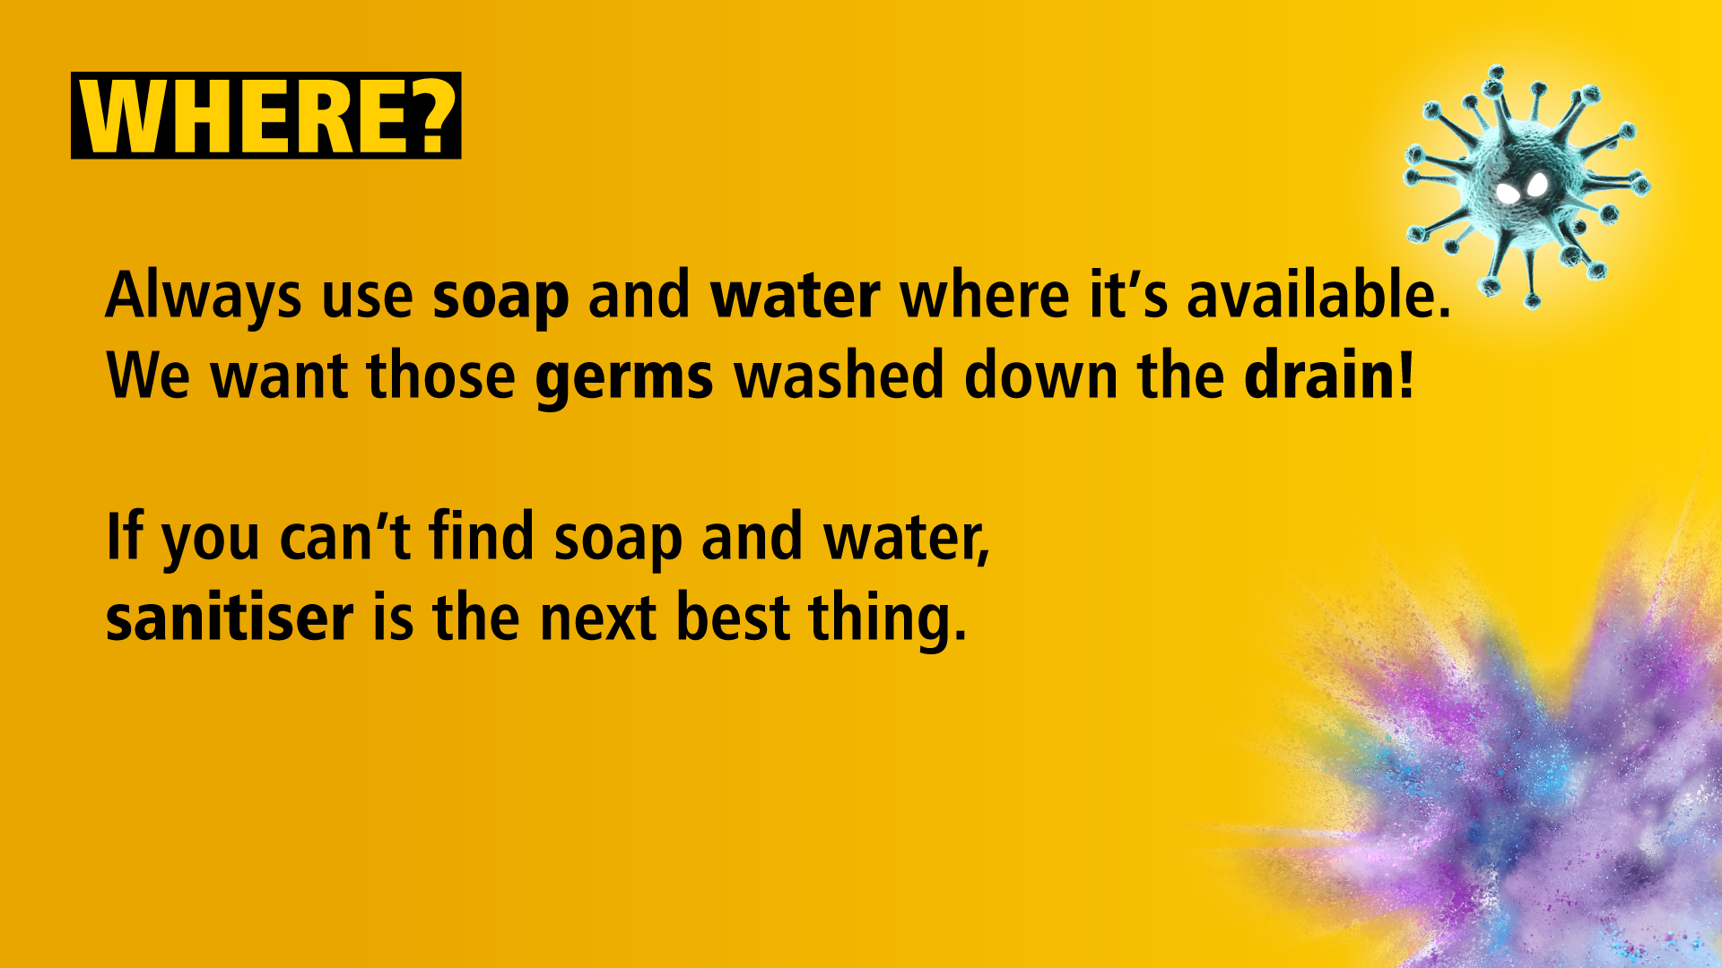

Slide 6
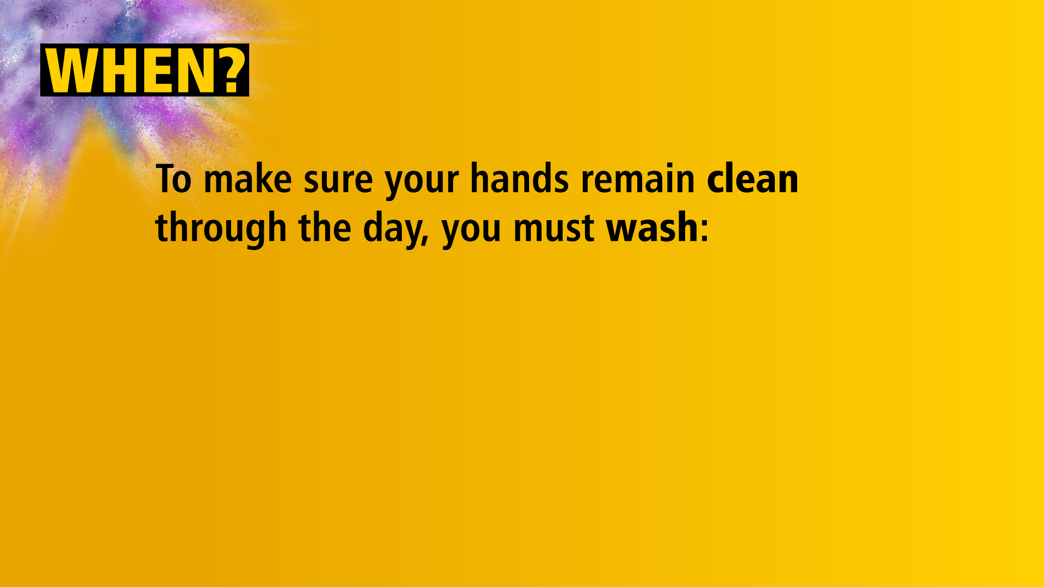


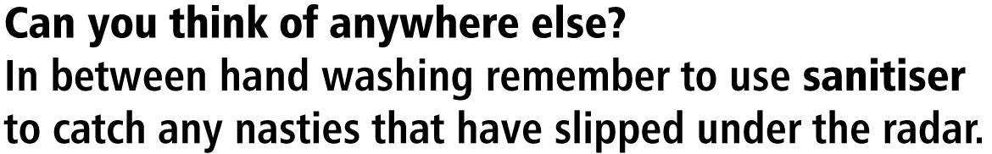

Slide 7
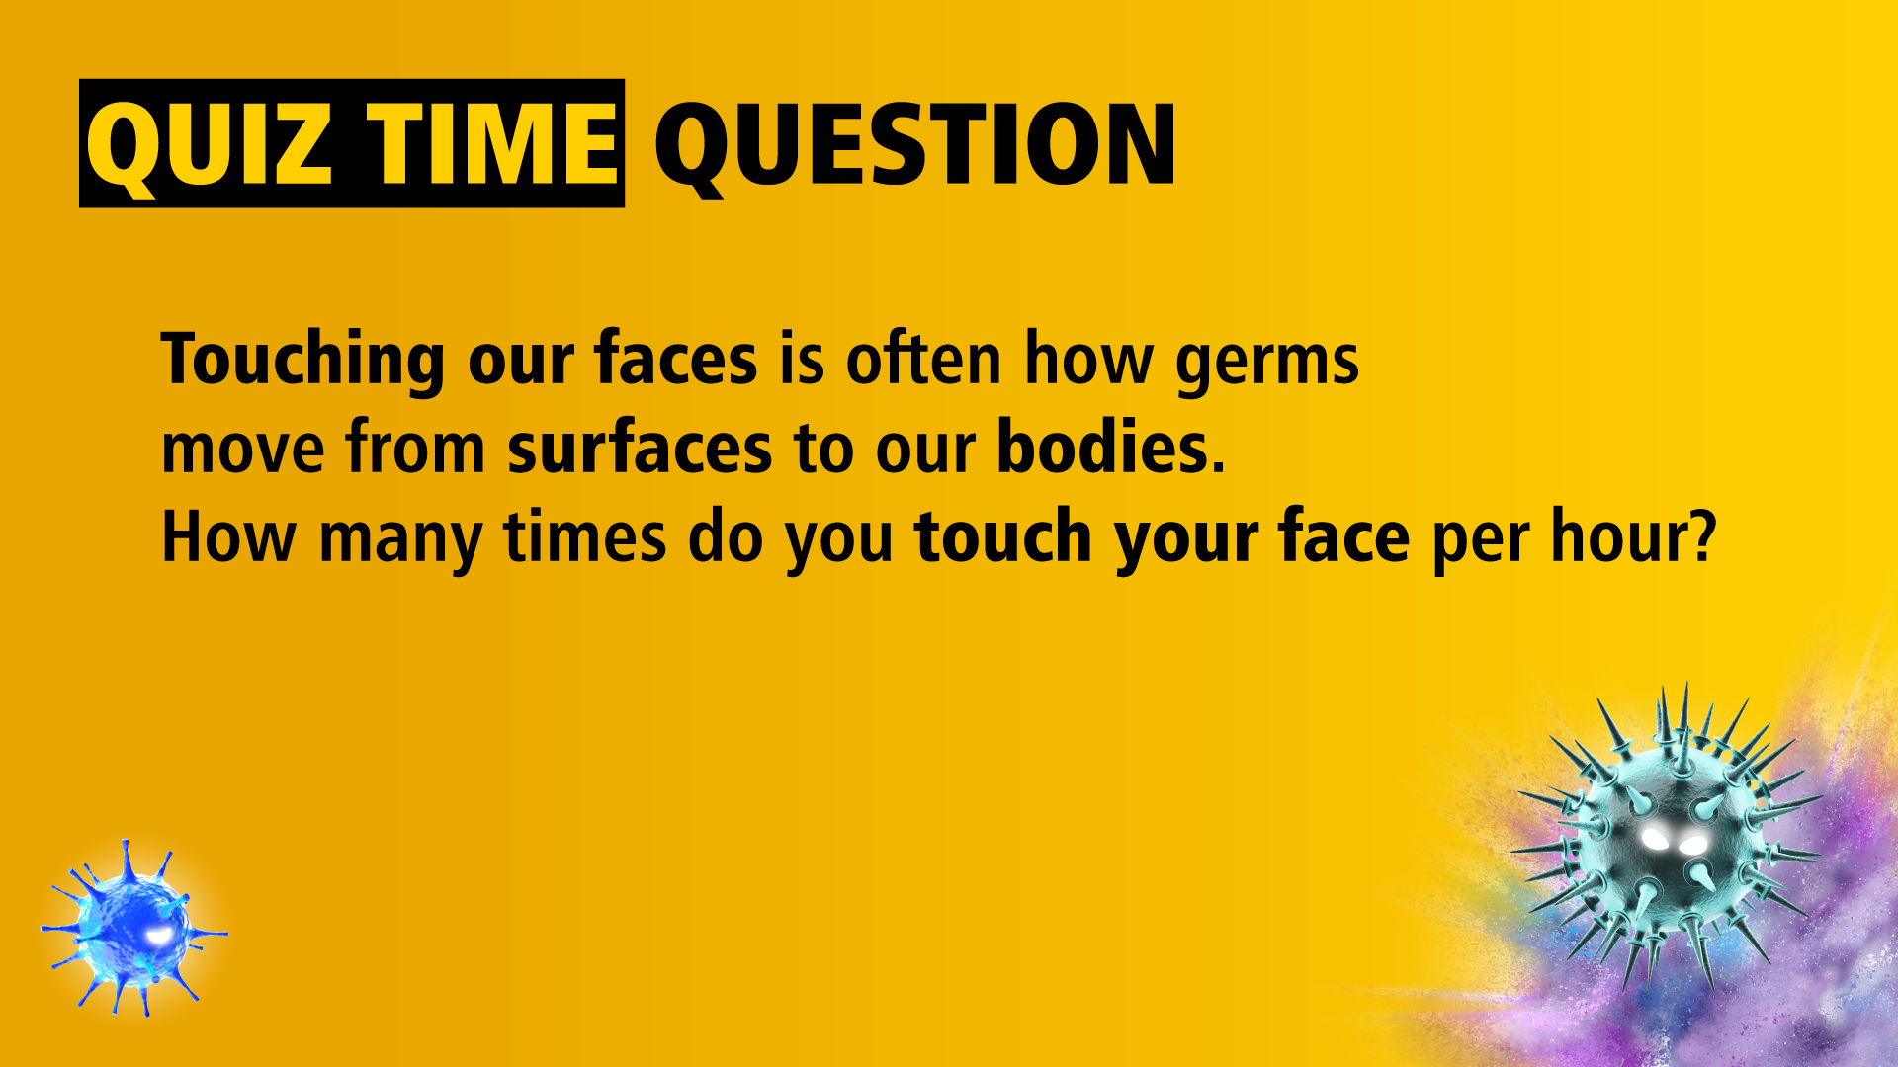




Slide 8
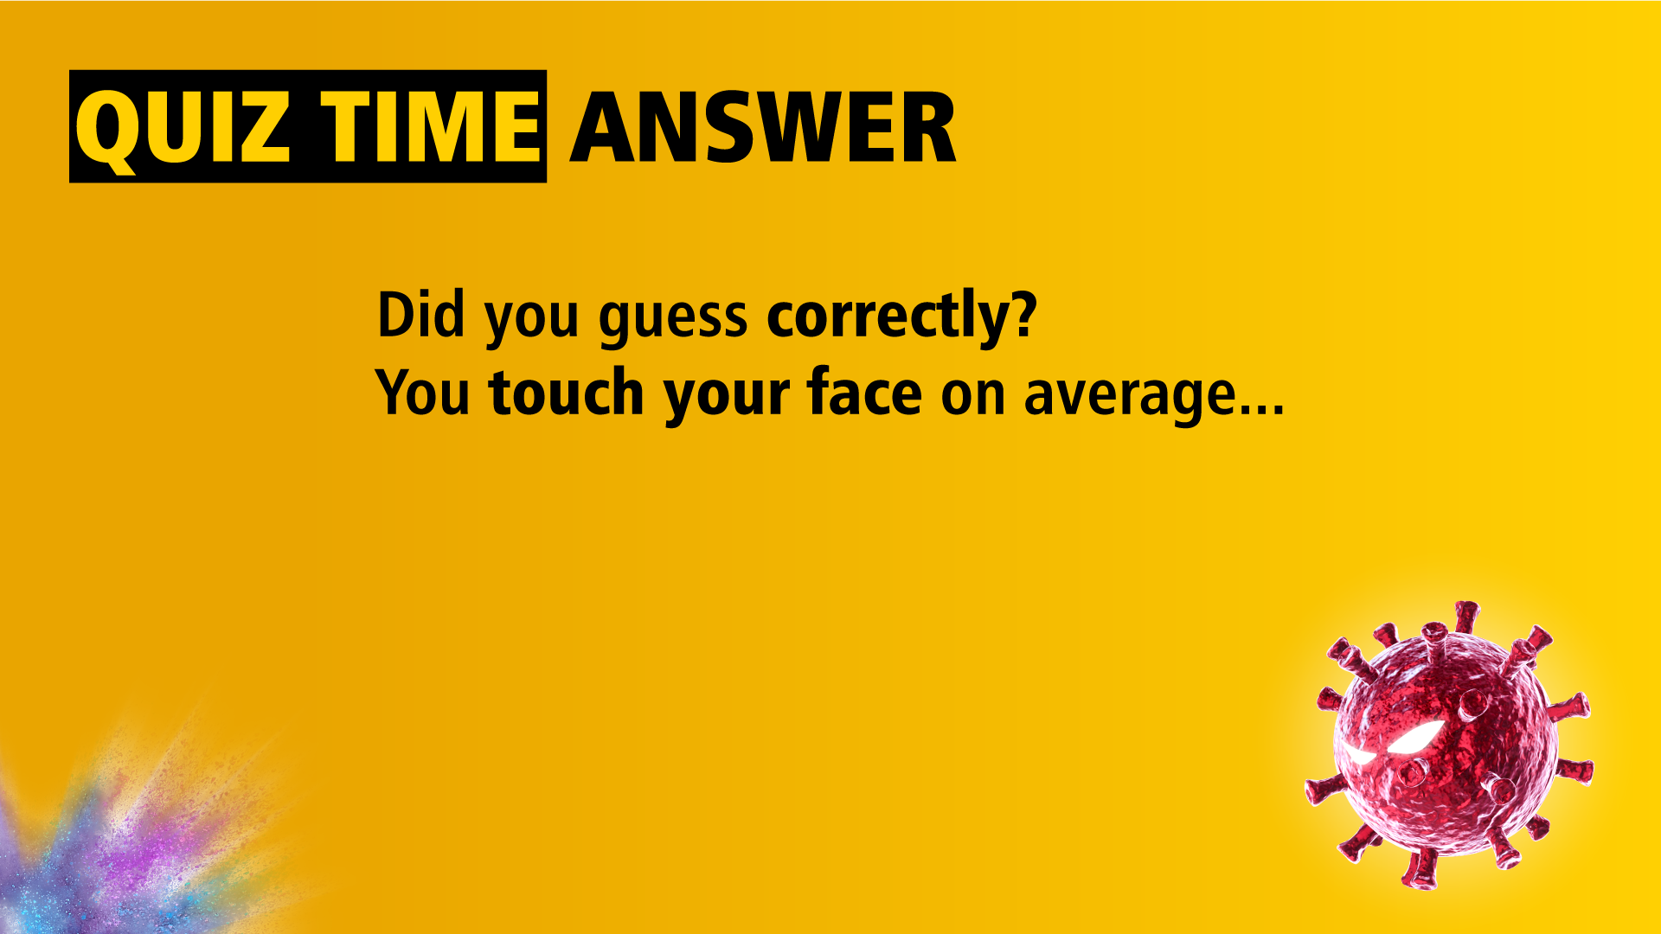

Source: https://www.forbes.com/sites/jvchamary/2020/07/30/coronavirus-face-touching/?sh=6b13d5b8375f

Slide 9
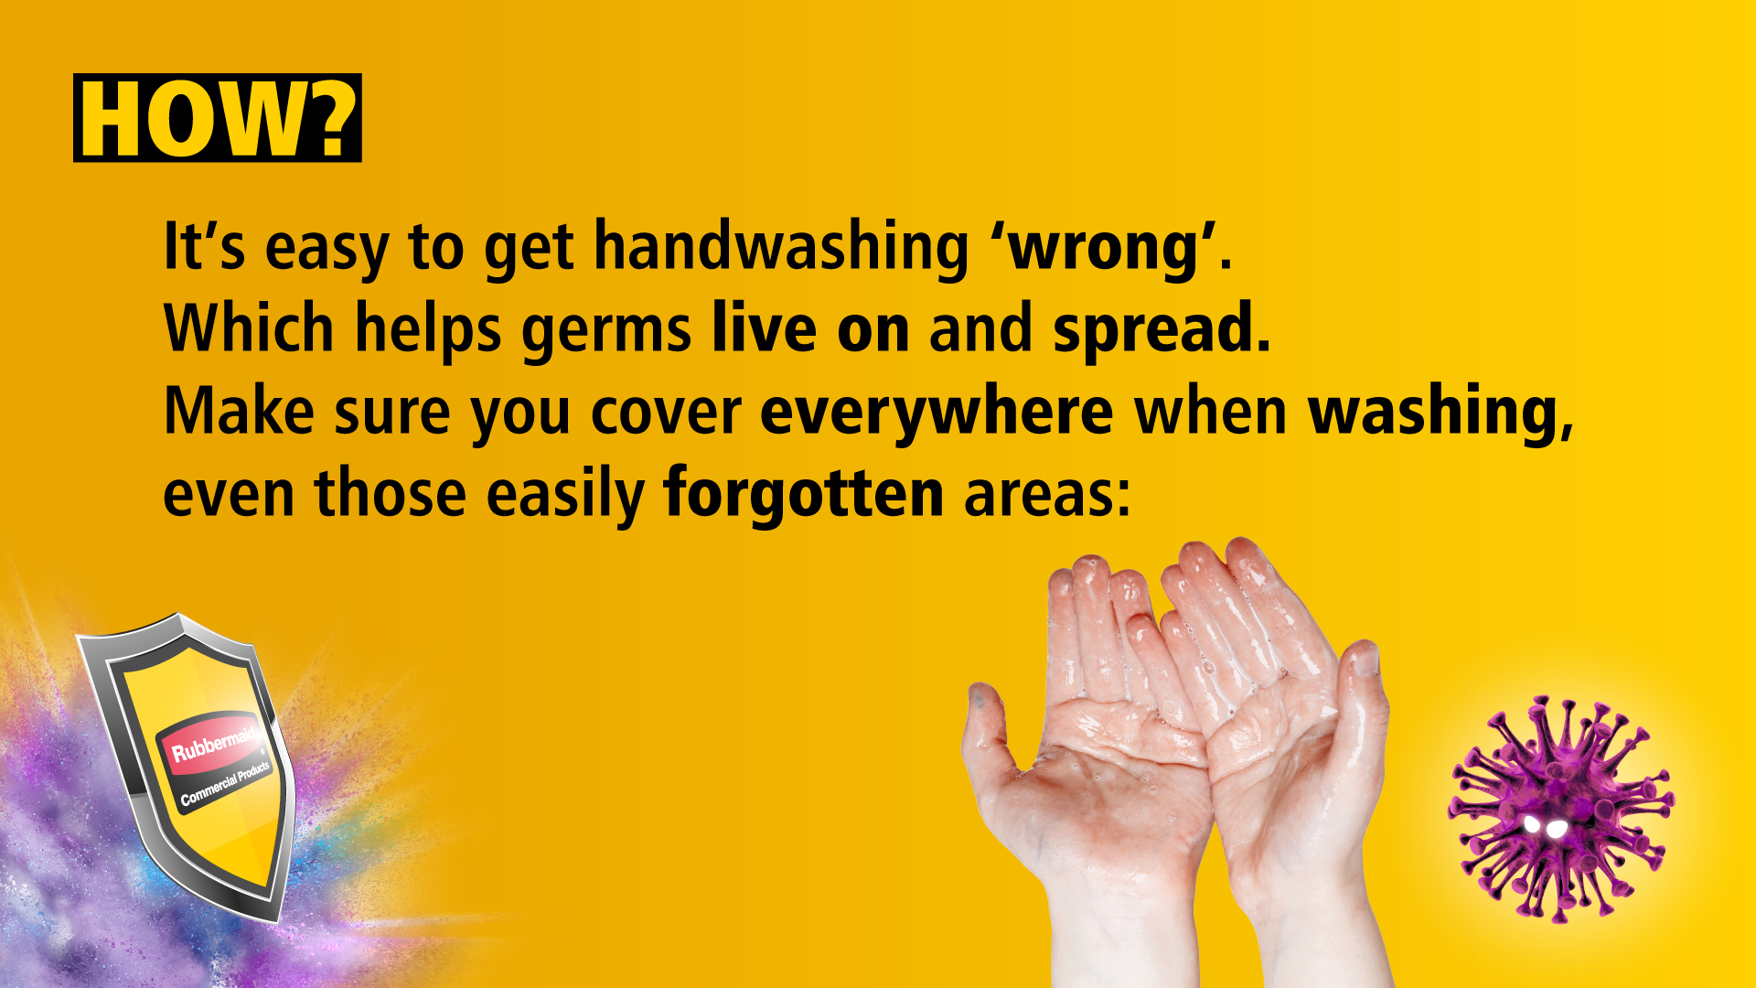






Slide 10


Slide 11
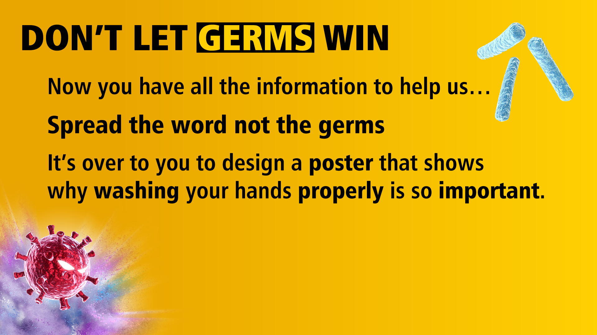
the

Slide 12


Slide 13

Teachers… here you can add any extra information to help your pupils begin their mission!

